Slide 1

Welcome to the
CITY NAME

Slide 2

Welcome!

Slide 3
Welcome Let’s get acquainted

Slide 4
Agenda TBD
9h00-9h30
9h30-10h15
10h15-11h00
11h00-11h15 PAUSE
11h15-12h00
12h00-12h45 LUNCH
12h45-13h15
13h15-14h15
14h15-14h30
14h30-15h15
15h15-16h00

Slide 5
Goal
Today is focused on practical skills (20% theory, 80% hands on).
All day long, you’ll learn about what is Life after initial deployment. All about governance & best practices following speakers instructions.

Slide 6
Step 0 Intro
Speaker Name
Titles
Website url

Slide 7
Goal
Getting to know Azure and the Portal

Slide 8
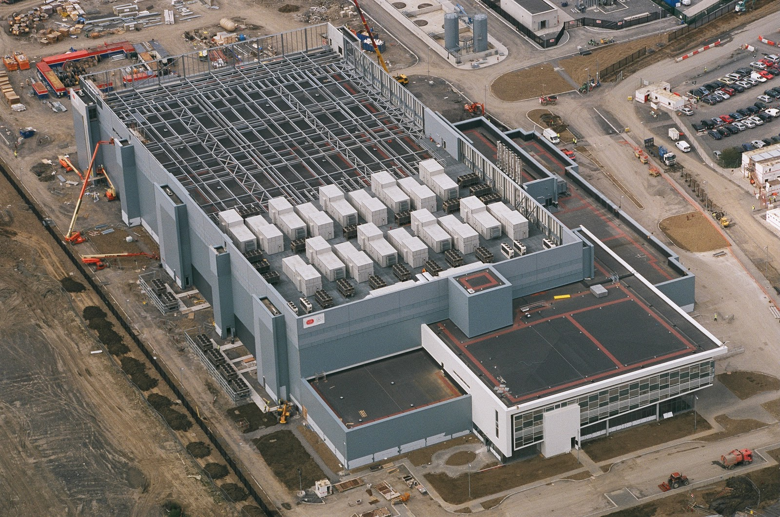

Slide 9
http://portal.azure.com

Slide 10
References:
Get started with Azure
Microsoft Azure Blog
Azure Updates
Cloud Platform roadmap
Azure Code Samples
Azure Quickstart Templates
AzureCAT Guidance
Cloud Design Patterns

